Slide 1
Explore New York’s boroughs to open a Japanese Restaurant.

Slide 2
Problem Statement
The objective is to explore the neighborhoods of New York city to track down highest & lowest ranking Japanese restaurants.

Slide 3
Data Acquisition.
New York City Data Containing the boroughs and Neighborhoods.
Latitude & Longitude coordinates of those neighborhoods
Venue Data related to restaurants.

Slide 4
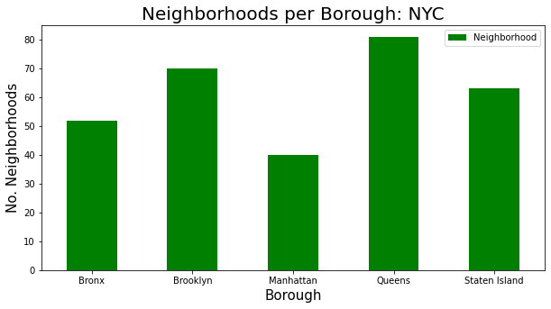
. Identifying total number of neighborhoods per borough

Slide 5
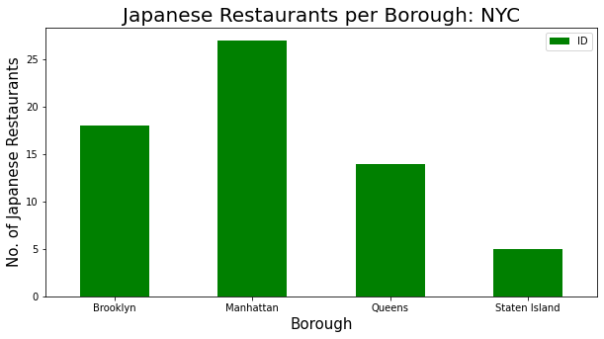
Identifying total number of Japanese restaurants per borough

Slide 6
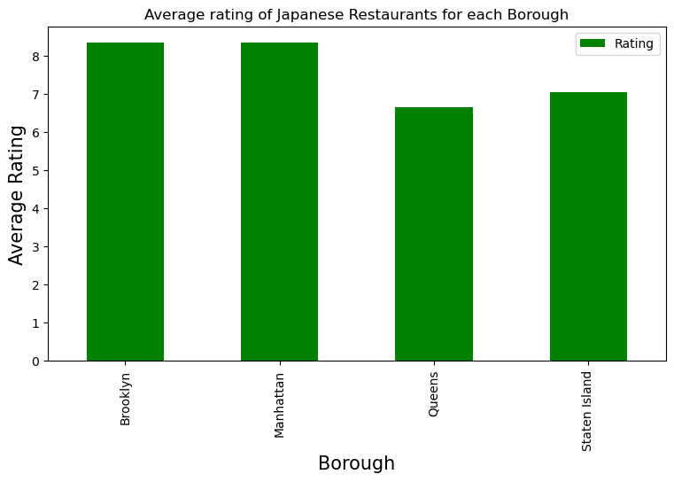
Average Ranking of Japanese Restaurants per Borough

Slide 7
Neighborhoods with Average Ranking
 | Borough | Neighborhood | Average Rating
1 | Manhattan | West Village | 8.00
2 | Brooklyn | Prospect Heights | 8.100
3 | Manhattan | Murray Hill | 8.175
1 | Queens | Little Neck | 8.00

Slide 8
Conclusion
Based on the analysis, we can say West Village & Little Neck neighborhoods have Japanese restaurants with the lowest ranking. I would recommend opening Japanese restaurants in any of those 2 neighborhoods because of less competition.

